Slide 1
TIME AND WORK

Slide 2
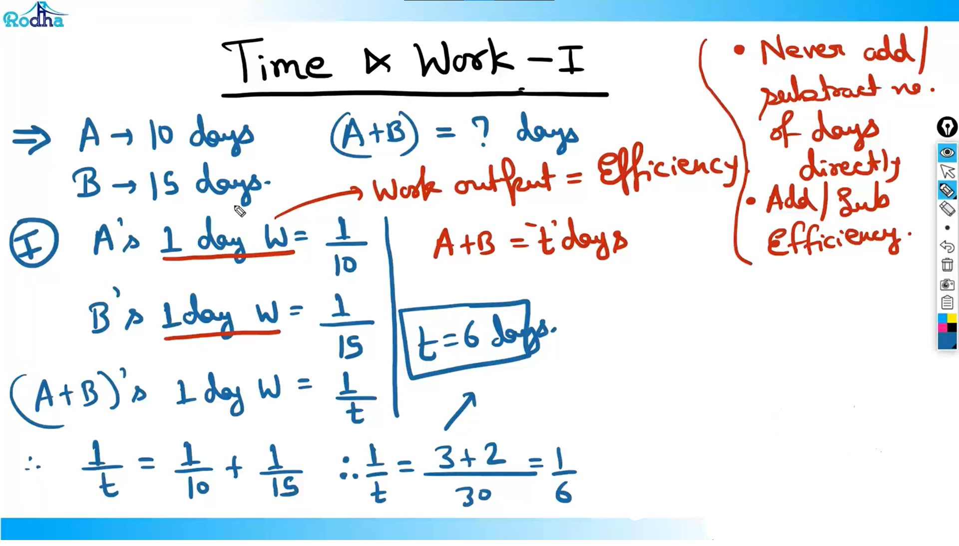

Slide 3
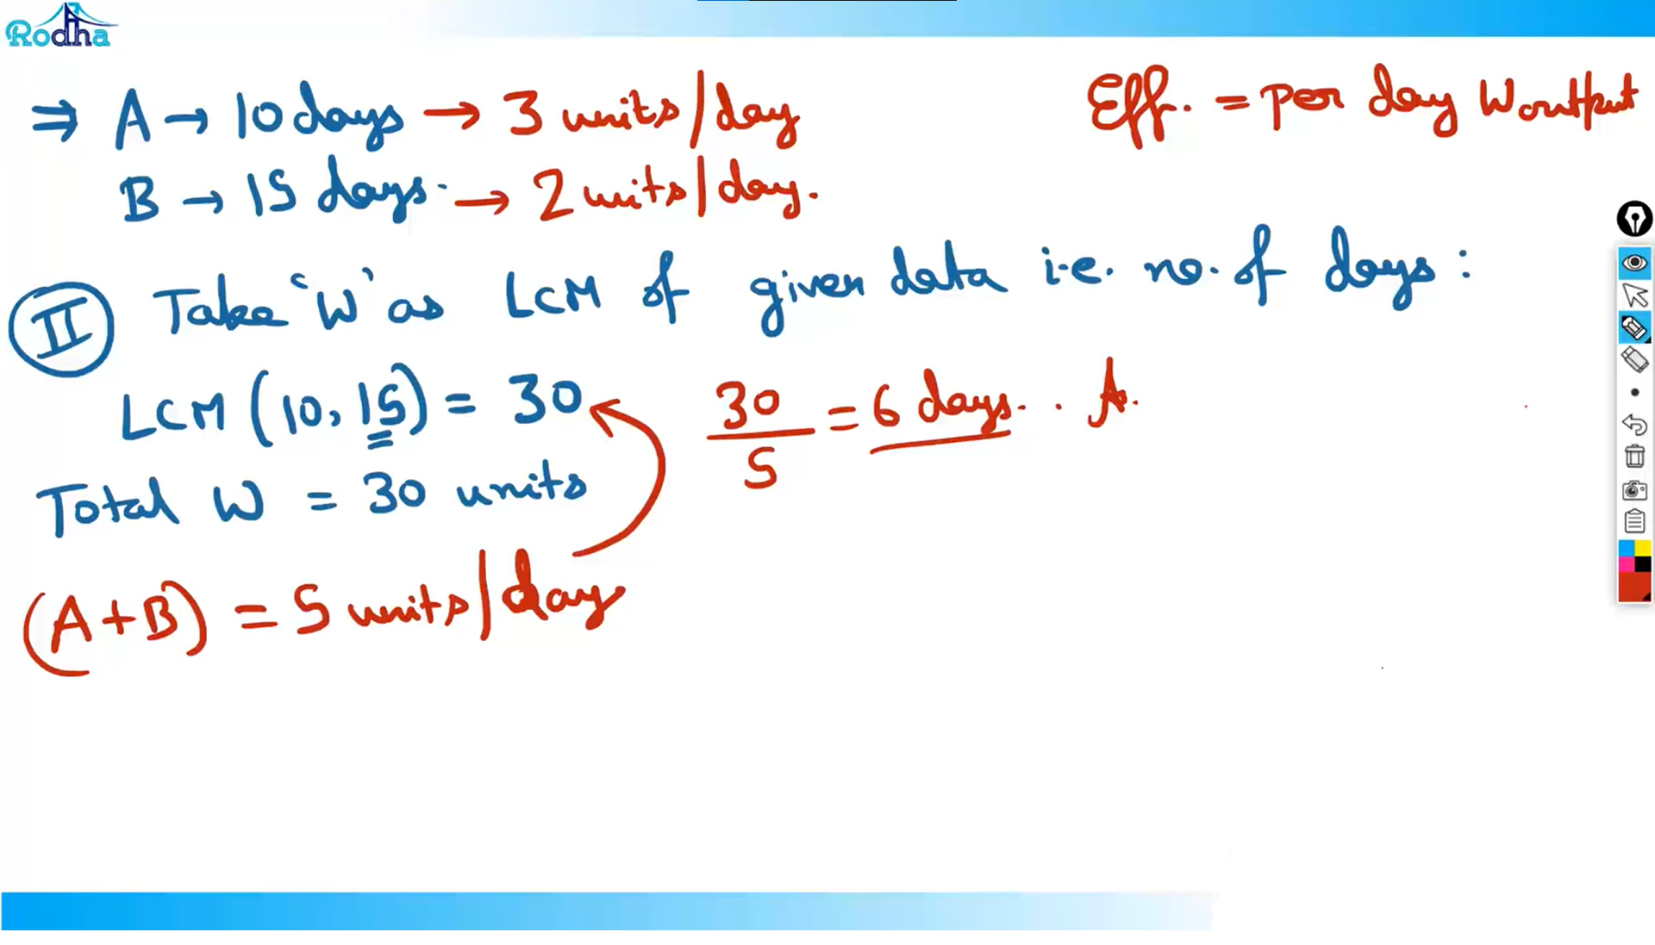

Slide 4
